Slide 1

Quantum Computing: A Journey into the Future of Information Processing
Quantum computing is a transformative technology that harnesses the principles of quantum mechanics to solve problems beyond the reach of classical computers. It holds the promise of revolutionizing fields from medicine and materials science to cryptography and artificial intelligence.

Slide 2
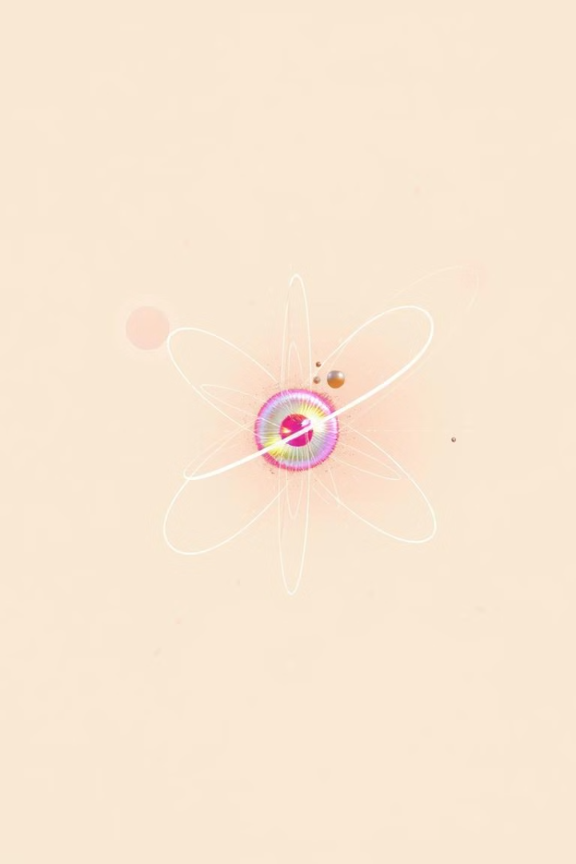
The Fundamentals of Quantum Mechanics: The Science Behind Quantum Computing
Quantum Superposition
Quantum Entanglement
A quantum system can exist in multiple states simultaneously, unlike classical bits that can only be 0 or 1.
Two or more quantum particles become interconnected, even at vast distances, influencing each other's states.
Quantum Tunneling
Quantum Measurement
Particles can pass through seemingly impenetrable barriers, defying classical physics.
Observing a quantum system causes its state to collapse into a single definite value.

Slide 3
Understanding Qubits: The Heart of Quantum Computing
Classical Bits
Qubits
Classical bits represent information as 0 or 1. They exist in a definite state, either on or off.
Qubits leverage quantum mechanics to exist in multiple states simultaneously, known as superposition.
Classical computers process information sequentially, limited to one state at a time.
Qubits unlock the potential for parallel processing, allowing quantum computers to explore many possibilities at once.

Slide 4
Superposition and Entanglement: Unlocking Quantum Parallelism
Superposition
Entanglement
Qubits can exist in multiple states simultaneously, unlike classical bits that are limited to 0 or 1. This allows quantum computers to explore a vast range of possibilities at once, leading to significant speedups for certain algorithms.
Entangled qubits become interconnected, influencing each other's states even when physically separated. This allows for a powerful form of correlation that can be exploited for tasks like secure communication and quantum computation.

Slide 5




Quantum Gates and Circuits: How Quantum Computers Process Information
Quantum Gates
Quantum gates are the fundamental building blocks of quantum circuits. These gates manipulate qubits in specific ways, performing operations like superposition and entanglement.
Quantum Circuits
Quantum circuits are sequences of quantum gates that operate on qubits. They are designed to solve specific problems by performing a series of computations.
Circuit Execution
When a quantum circuit is executed, the qubits undergo a series of transformations based on the applied gates, leading to a final output state that holds the solution.

Slide 6

Key Quantum Algorithms: Revolutionizing Computation
Shor’s Algorithm
Grover’s Algorithm
Efficiently factors large integers, breaking modern encryption schemes. This has significant implications for cryptography and cybersecurity.
Speeds up unsorted database searches. It offers advantages in areas like drug discovery, optimization, and machine learning.
Quantum Fourier Transform (QFT)
Quantum Phase Estimation
A fundamental building block for many quantum algorithms, it enables efficient analysis of data in quantum systems.
Estimates the eigenvalues of a quantum operator, a crucial step in solving various problems in quantum physics and chemistry.

Slide 7
Quantum Computing Hardware: Technologies and Architectures
Superconducting Qubits
1
Superconducting qubits are fabricated from superconducting materials, cooled to near absolute zero.
Trapped Ion Qubits
2
Trapped ion qubits use lasers to manipulate individual ions confined in electromagnetic traps.
Neutral Atom Qubits
3
Neutral atom qubits utilize lasers to control atoms in a vacuum chamber, leveraging their internal states as qubits.
Photonic Qubits
4
Photonic qubits are based on light particles, or photons, offering potential for long-distance communication.

Slide 8
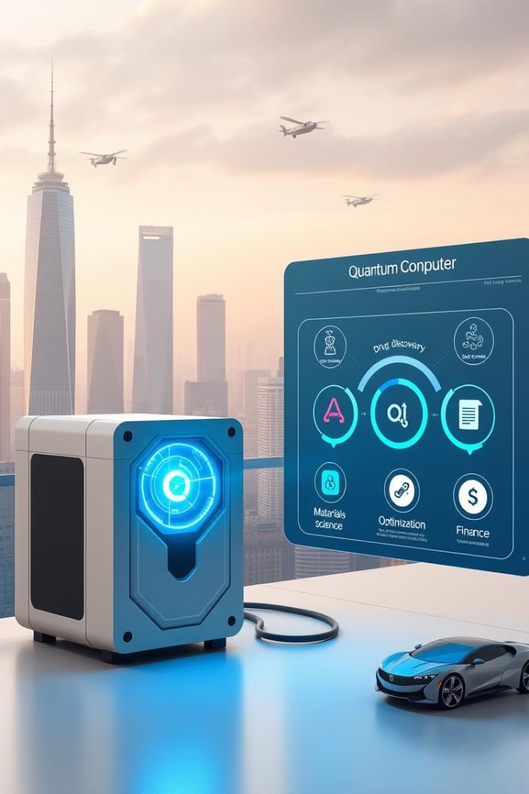
Real-World Applications of Quantum Computing: From Cryptography to Drug Discovery
1
2
Cryptography
Drug Discovery
Quantum computers could break current encryption algorithms, requiring new, quantum-resistant methods.
Simulating molecular interactions to accelerate the development of new drugs and therapies.
3
4
Materials Science
Optimization
Designing new materials with enhanced properties by modeling atomic interactions.
Solving complex optimization problems in areas like logistics, finance, and machine learning.

Slide 9
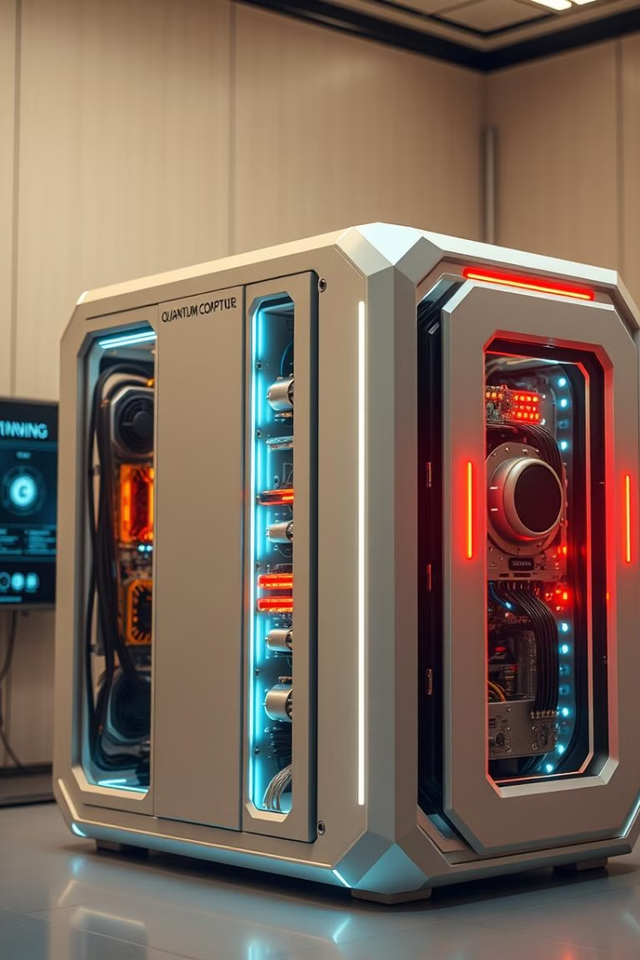
Challenges in Quantum Computing: Error Rates, Scalability, and Decoherence
Error Rates
Scalability
Quantum systems are highly susceptible to errors, introducing noise and uncertainty into calculations. This can significantly impact the accuracy and reliability of quantum algorithms.
Building large-scale quantum computers with a sufficient number of qubits remains a major challenge. Scaling up while maintaining performance and controlling errors is crucial for practical applications.
Decoherence
Qubits are fragile and easily interact with their environment, losing their quantum properties. This process, called decoherence, limits the duration of quantum computations and poses a significant obstacle to their practical use.

Slide 10





The Future of Quantum Computing: Transformative Potential and Industry Leaders
Quantum Supremacy
1
Demonstrating quantum computers solving problems beyond classical capabilities.
2
Practical Applications
Real-world use in fields like drug discovery, materials science, and cryptography.
3
Quantum Advantage
Quantum computers offering significant speedup and efficiency advantages over classical computers.
4
Quantum Ecosystem
A robust ecosystem of hardware, software, and applications supporting quantum computing.
5
Quantum Computing for All
Broad accessibility and adoption of quantum computing across industries and research areas.

